Slide 1
M3-MIFARE DESFire Training
MIFARE DESFire EV1 Crypto and Security
Abu Ismail, BUID CAS
MIFARE DESFire EV1
Standard Product Training
2013

Slide 2
Content
Different types of crypto and secure protocol
Authentication
Data confidentiality
Data integrity
Examples
Short overview of hardware securities
Discussion of some known attacks and implemented counter measures
M309_MIFARE DESFire Training - MIFARE DESFire EV1 Crypto and Security_AIv13.01.ppt

Slide 3

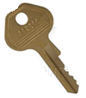



MIFARE DESFire EV1 multiple crypto options
3 types of crypto algorithm
Application
Attribute to application and card level
TDES with 16-byte Key
AES-128
Independent
2KTDES
3KTDES
AES with 16 byte key
TDES with 24-byte key
K1 = K2, DES
K1 ≠ K2, TDES
True multi app with
multi crypto.
Standard and DESFire Native TDES
Support both
MF3ICD40
MF3ICD81/41/21
M309_MIFARE DESFire Training - MIFARE DESFire EV1 Crypto and Security_AIv13.01.ppt

Slide 4
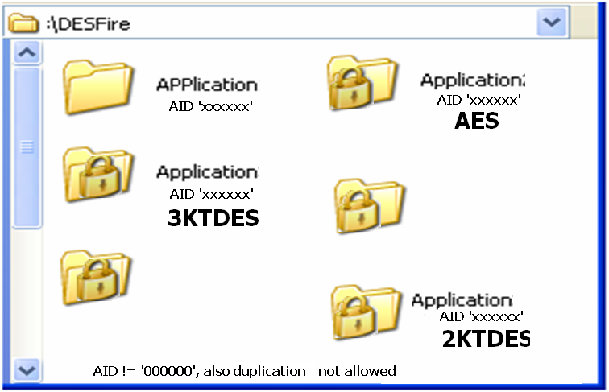
MIFARE DESFire EV1 applications
:\MIFARE DESFire EV1
Can be authenticated in standard
TDES mode
Can be authenticated in DESFire
Native crypto mode
M309_MIFARE DESFire Training - MIFARE DESFire EV1 Crypto and Security_AIv13.01.ppt

Slide 5


MIFARE DESFire EV1 Crypto setting
At Card level: Default / Virgin 2KTDES (k1=k2)
Can be changed to 3KTDES or AES using “change key” command.
Can only be changed after right authentication
Can be even freezed (not changeable)
At Application level:
Crypto has to be defined at creation of application
Crypto type cannot be changed for the created application
Keys can be changed if allowed after the right authentication
M309_MIFARE DESFire Training - MIFARE DESFire EV1 Crypto and Security_AIv13.01.ppt

Slide 6
MIFARE DESFire EV1 authentication
3-Pass mutual authentication
Key is never exchanged
Based on random numbers
Session key is generated based on the random numbers
Authentication starts new session
Session key is used for all crypto calculations
M309_MIFARE DESFire Training - MIFARE DESFire EV1 Crypto and Security_AIv13.01.ppt

Slide 7
MIFARE DESFire EV1 authentication
PCD
3-pass mutual authentication
MIFARE
DESFire EV1
AUTHENTICATE
Authentication command & key number
KEY
PCD step a
Decipher RndB
With same key
GENERATE
8/16 byte Random RndB,
Encipher with key

Standard TDES/AES enciphered RndB
2KTDES/3KTDES/
AES CRYPTO
UNIT
2KTDES/3KTDES/
AES CRYPTO
UNIT
PCD step b
‚
Generate RndB’
GENERATE 8/16 byte RndA
Concat RndA RndB’
TDES/AES enciphered RndA+RndB’
Encipher chain
VERIFY RndB’,
Generate RndA’
Encipher with key
ƒ
Standard TDES/AES enciphered RndA’
PCD step c
Decipher RndA’
VERIFY RndA’
Assemble Session Key
M309_MIFARE DESFire Training - MIFARE DESFire EV1 Crypto and Security_AIv13.01.ppt

Slide 8
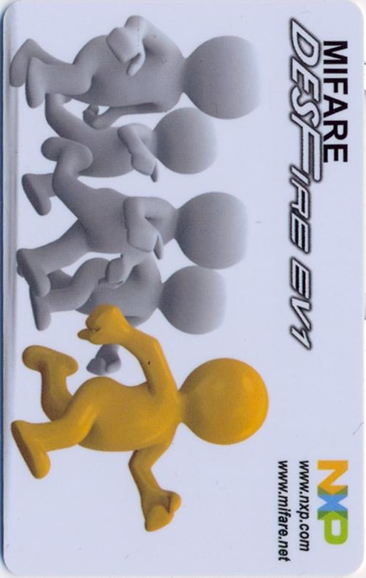
MIFARE DESFire EV1 AES authentication example
Key = 00000000000000000000000000000000
PCD
AA 01
Cmd keyNr
Decrypt :
IV = “0000000000000000 0000000000000000”
RndB = A050C062433DC0D5DD34689768305B3B
IV = 2EBE806AC4AE02B67A61101085C04344
RndB´= 50C062433DC0D5DD34689768305B3BA0
Generate RndA:D678A554512E4D3A469580A72D9A8890
Ek (RndA+RndB´) =2EB5DEC32216672829A43342FF0AE401D1E2314DDA3535D9027F13CFB03ACB2C
IV =D1E2314DDA3535D9027F13CFB03ACB2C
AF2EBE806AC4AE02B67A61101085C04344
Status
Ek(RndB)
3-pass Mutual Authentication
AF+Ek(RndA+RndB´)
Decrypt:
RndA´ =78A554512E4D3A469580A72D9A8890D6
RndAr = RndAs?
Status
Ek(RndA´)
001E8D416DDB7875960D1FF8DE64E3C152
Session Key = D678A554A050C0622D9A889068305B3B
Reset IV= “00000000000000000000000000000000”
M309_MIFARE DESFire Training - MIFARE DESFire EV1 Crypto and Security_AIv13.01.ppt

Slide 9
MIFARE DESFire EV1 communication
Encrypted communication
MACed (CMACed) communication
Plain communication
M309_MIFARE DESFire Training - MIFARE DESFire EV1 Crypto and Security_AIv13.01.ppt

Slide 10
MIFARE DESFire EV1 encrypted communication
Preparation of data for standard TDES, 3KTDES and AES encryption
CRC32 is added to the data.
All the parameters and command are included in the CRC32 calculation for C-APDU
The status byte is placed in the trailer to calculate the CRC32
Data is padded with 0x00 to multiples of 8 bytes for DES and 16 bytes for AES
If the length of data is given with “00 00 00”, padding is done with one “80”, followed by the required number of “00” (acc. ISO 9797-1)
Length of resulting data is always n*8 bytes for DES and n*16 for AES.
M309_MIFARE DESFire Training - MIFARE DESFire EV1 Crypto and Security_AIv13.01.ppt

Slide 11
MIFARE DESFire EV1 encrypted communication example
Write 40 bytes
e.g. AES Crypto
DESFire specific CRC32: Calculated on Cmd+ file no + offset + Length + 40 bytes
40 bytes + 4-byte CRC32 + 4-byte padding
Standard AES Enciphering
Standard AES Enciphered 48 bytes
Cmd+ file no + offset +Length
Standard AES Enciphered 48 bytes
PCB+CID
Cmd+ file no + offset +Length
Standard AES Enciphered 48 bytes
2-byte CRC
Sending 60 bytes
T = CL
Note: If everything is ok, then response = ’00’ + 8-byte CMAC calculated on ‘00’
M309_MIFARE DESFire Training - MIFARE DESFire EV1 Crypto and Security_AIv13.01.ppt

Slide 12
MIFARE DESFire EV1 encrypted communication example
e.g. AES Crypto
Read 40 bytes : encrypted communication
Received 53 bytes
T = CL
PCB+CID
status
Standard AES Enciphered 48 bytes
2-byte CRC
Standard AES Deciphering
40 bytes plain+ 4-byte CRC32 + 4-byte padding
DESFire specific CRC32: Calculated on 40 bytes + status “00”
Note: Although in the C-APDU no CMAC is transmitted, but CMAC needs to be calculated on the C-APDU
to update the IV, which is required in the deciphering
M309_MIFARE DESFire Training - MIFARE DESFire EV1 Crypto and Security_AIv13.01.ppt

Slide 13
MIFARE DESFire EV1 CMACed communication
CMD, parameters are placed in front of the data for CMAC calculation in C-APDU
status byte is appended at last to calculate CMAC for R-APDU
M309_MIFARE DESFire Training - MIFARE DESFire EV1 Crypto and Security_AIv13.01.ppt

Slide 14
MIFARE DESFire EV1 CMACed communication example
Write 38 bytes: CMACed communication
38 bytes
8-byte CMAC: calculated on Cmd+ file no + offset +Length + 38 bytes data
38 bytes + 8-byte CMAC
Cmd+ file no + offset +Length
46 bytes
PCB+CID
Cmd+ file no + offset +Length
46 bytes
2-byte CRC
Sending 58 bytes
T = CL
M309_MIFARE DESFire Training - MIFARE DESFire EV1 Crypto and Security_AIv13.01.ppt

Slide 15
MIFARE DESFire EV1 CMACed communication example
Read 38 bytes: CMACed communication
Received 51 bytes
T = CL
PCB+CID
status
38 bytes data + 8-byte CMAC
2-byte CRC
Calculate CMAC on 38 bytes data +status
Compare CMAC with received CMAC: ok
38 bytes data
M309_MIFARE DESFire Training - MIFARE DESFire EV1 Crypto and Security_AIv13.01.ppt

Slide 16
MIFARE DESFire EV1: CRC or CMAC load
C – APDU:
parameters
If required, CMAC is also calculated, even no data or parameters present
3D
01
000000
040000
xxxxxxx
length
data
File no
offset
CRC16 or MAC is calculated only for data in DESFire Native mode
cmd
CRC32 or CMAC calculated over the complete APDU in standard TDES
and AES
R – APDU:
00
xxxxxxx
If required, CMAC is also calculated, even no data present
status
data
CRC16 or MAC is calculated only for data in DESFire Native mode
CRC32 or CMAC calculated over the data + status
in standard TDES and AES
M309_MIFARE DESFire Training - MIFARE DESFire EV1 Crypto and Security_AIv13.01.ppt

Slide 17
MIFARE DESFire EV1 plain communication
It is also possible to make authentication mandatory but communication plain.
After standard TDES or AES authentication, plain communication requires CMAC calculation to update IV by PCD, PICC response includes CMAC.
M309_MIFARE DESFire Training - MIFARE DESFire EV1 Crypto and Security_AIv13.01.ppt

Slide 18
MIFARE DESFire EV1 different communication
Std. TDES and AES crypto mode
Communication setting | Access Right | Preceding Authentication | Resulted communication
Plain | free | No | Plain
Plain | free | Yes | PCD calculates CMAC for cmd to update IV, but not send. PICC response includes CMAC.
Plain | Key n | Must with key n
CMACed | Key n | Must with key n | PCD calculates CMAC for cmd, only sends if data field is present. PICC response includes CMAC.
Encrypted | Key n | Must with key n | PCD encrypts data if data field is present, if data field is absent calculates CMAC but doesn’t send. PICC response is encrypted data if data field is present, if data field is absent PICC response includes CMAC.
Which one to select ?
M309_MIFARE DESFire Training - MIFARE DESFire EV1 Crypto and Security_AIv13.01.ppt

Slide 19
MIFARE DESFire EV1 hardware securities
M309_MIFARE DESFire Training - MIFARE DESFire EV1 Crypto and Security_AIv13.01.ppt

Slide 20
MIFARE DESFire EV1 hardware security 1/2
Secure asynchronous processor architecture:
  Advanced process technology
  Many metal layers
  Deep sub micron technology
  Highly reliable Non-Volatile technologies
Glue Logic (no digital blocks visible)
RAM/ROM/EEPROM Encryption:
  Secure storage of card keys
  Secure storage of session keys
  Calculation results
  Encrypted storage of data
Active Shielding
  Probing & manipulation resistance
Exception Sensors
  Voltage (incl. Glitch sensor)
  Temperature
  Light
  Frequency
RAM
RAM
EEPROM
CPU
Coprocessor
ROM
Logic
No functional blocks can be identified
No Bus system can be found
RAM and functional units fully encrypted
Multi layer design makes analysis and reverse engineering extremely difficult
DESFire EV1 is CC EAL4+ certified and conformed to the "Smartcard IC platform Protection Profile"
M309_MIFARE DESFire Training - MIFARE DESFire EV1 Crypto and Security_AIv13.01.ppt

Slide 21
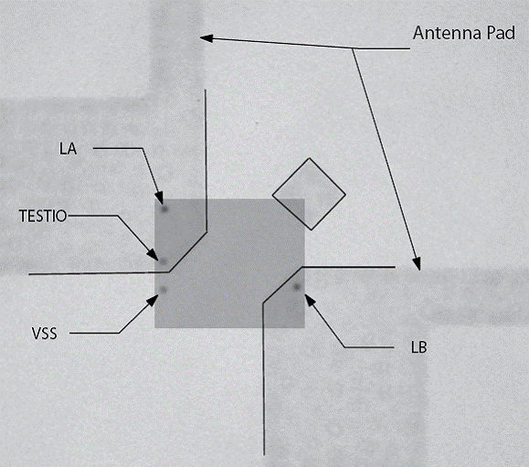
MIFARE DESFire EV1 hardware security 2/2
Internal Clock Oscillator for EEPROM access
Constant Power Source
Test-Mode locked by
  Metal shackle in dicing area (physically cut @ IC production)
  EEPROM-signature
  Test Pad, VSS Pad physically disconnected
True Random Number Generator
  AIS-31 compliant
  Common Criteria Certified
Data consistency:
  Verified internally by CRCs
  Bit-inverse double saving of security settings
  Self locking Mechanism
Easy bonding process as no care required for other pads
DESFire EV1 is CC EAL4+ certified and conformed to the "Smartcard IC platform Protection Profile"
M309_MIFARE DESFire Training - MIFARE DESFire EV1 Crypto and Security_AIv13.01.ppt

Slide 22
Discussion of some known attacks
and built-in protection in MIFARE DESFire EV1
M309_MIFARE DESFire Training - MIFARE DESFire EV1 Crypto and Security_AIv13.01.ppt

Slide 23
Counter measures invasive
Attacks | Protection in MIFARE DESFire EV1?
Reverse Engineering
Bus probing
EEPROM altering by voltage, light,, frequency
Reviving test mode
Yes (Glue logic, multilayer, asynchronous)
Yes (bus is hidden)
Yes (sensors, CRC check)
Yes (metal shackle)
M309_MIFARE DESFire Training - MIFARE DESFire EV1 Crypto and Security_AIv13.01.ppt

Slide 24
Counter measures non-invasive
Attacks | Protection in MIFARE DESFire EV1?
Timing analysis (TA)
Power analysis, SPA, DPA, HO-DPA
Glitch attack :fault generation, with voltage, frequency, DFA
Data remanence
Yes (same time for processing 0 or 1), intelligent code.
Yes
Yes (sensors, intelligent code)
Yes
M309_MIFARE DESFire Training - MIFARE DESFire EV1 Crypto and Security_AIv13.01.ppt

Slide 25
Counter measures man-in-middle attacks
Attacks | Protection in MIFARE DESFire EV1?
Plain text / brute force
Replay
Reply
Relay
Eavesdropping
Bit flipping
Yes (strength on TDES and AES, key version, diversifications)
Yes (IV is always different)
Yes (involves always different cryptogram)
Needs extra design, (e.g. PIN, -MRZ.
Can be made difficult with careful PCD design).
Yes (encrypted)
Yes (MAC, CMAC, CRC16, CRC 32)
M309_MIFARE DESFire Training - MIFARE DESFire EV1 Crypto and Security_AIv13.01.ppt

Slide 26

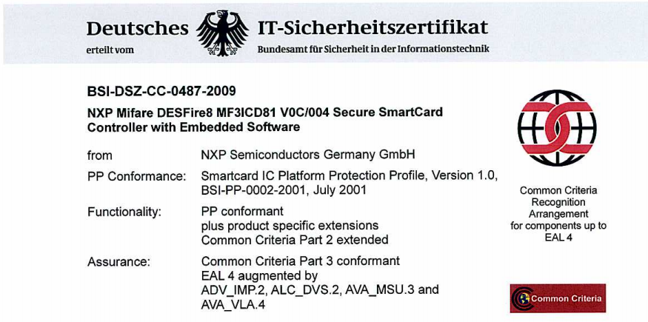
MIFARE DESFire EV1: HW and SW both are CC EAL4+ certified
CC EAL 4+
http://www.commoncriteriaportal.org
M309_MIFARE DESFire Training - MIFARE DESFire EV1 Crypto and Security_AIv13.01.ppt

Slide 27
Certified product – Why?
Solution providers and system integrators have a “trusted independent” 3rd party certificate to security aspects.
The CC certification validates, the security functions of the product are correctly implemented as written in the documentation and specification.
The CC certification and its security levels can be used as a scale for security “quality” of different products by different suppliers.
The CC certification guarantees the robustness and resistance of the product against attacks (as mentioned in the CC documents).
The CC certification requires to define the usages of product and complete life-cycle (IC production to disposal), - usually documented in “User guidance manual”.
Having certification for both HW and SW releases users to go for certification themselves. (with self developed OS the user requires individual certification.)
M309_MIFARE DESFire Training - MIFARE DESFire EV1 Crypto and Security_AIv13.01.ppt

Slide 28
Thank you very much.
We appreciate your feedback.
Abu Ismail
Senior Engineer, Customer Application Support
Business Unit Identification
NXP Semiconductors Germany GmbH
Stresemannallee 101, 22529 Hamburg, Germany
Tel: +49(0)40 5613 5070, Mob:+49(0)15115210535, Fax:+49(0)40561365070
abu.ismail@nxp.com, http://www.nxp.com, http://www.mifare.net
M309_MIFARE DESFire Training - MIFARE DESFire EV1 Crypto and Security_AIv13.01.ppt

